Slide 1



Library Management System Project Presentation
Welcome to the presentation of our Library Management System, a robust console-based C program designed to revolutionise book management.

Slide 2




Problem Definition: Why Automate Library Management?
Manual Inefficiencies
Tracking Difficulties
Project Scope
Traditional library processes are prone to errors, redundancy, and significant inefficiencies in record-keeping.
Challenges include inaccurate records, slow book searches, errors in issuing/returning, and difficulties in tracking availability.
Our solution aims to develop a console-based C program to automate book management, drastically improving accuracy and streamlining library operations.

Slide 3



Solution Approach: System Design & Architecture
Our Library Management System is built as a modular C program, leveraging fundamental concepts such as structures, arrays, and functions to ensure organised and efficient data handling.
The system incorporates core modules for essential library tasks, each designed for optimal performance and user experience:
Add Book
Issue Book
Return Book
Delete Book
Search Book
Crucially, validation checks are embedded to prevent duplicate book IDs and titles, ensuring data integrity. A detailed flowchart guides the execution flow, guaranteeing smooth and intuitive user interaction.

Slide 4









Key Algorithms Overview
Add Book
Input ID, check for duplicates, input details, insert record, and confirm.
Issue Book
Input ID, search, decrement quantity if available, and notify if not.
Return Book
Input ID, search, and increment quantity.
Delete Book
Input ID, locate, remove, and shift records.
Search Book
Input ID and display details if found.

Slide 5
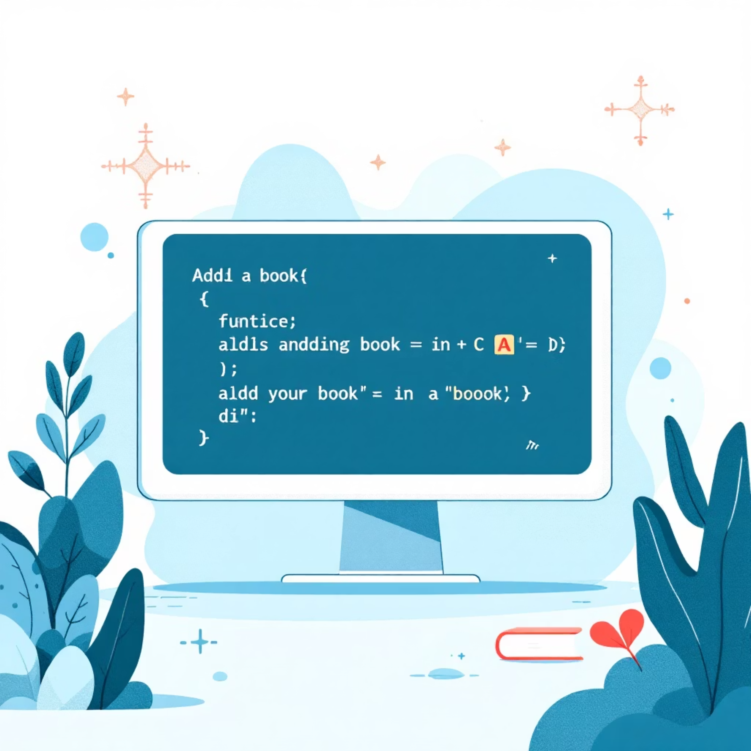



Live Code Demonstration: Core Functionalities
We will now showcase the system's capabilities directly from the VS Code environment, highlighting its file structure and the efficiency of its key functions:
addBook(): For seamlessly adding new books.
issueBook(): To manage book loans efficiently.
returnBook(): For processing returned books.
deleteBook(): To remove book records from the system.
searchBook(): For quick retrieval of book details.
Watch as we demonstrate adding a new book, issuing it to a user, processing its return, and finally, searching for its details. Observe the clear console input prompts and immediate output confirmations that make the system intuitive and reliable.

Slide 6


Novelty & Contributions
Duplicate Entry Prevention
Unique dual validation on both book ID and title ensures data integrity, preventing redundant records.
Modular Design
Enhances maintainability and scalability, making future updates and expansions straightforward.
Console-Based Simplicity
Guarantees easy deployment and operation without reliance on heavy external dependencies.
Future-Ready Foundation
Provides a solid base for integrating advanced features like GUI, database support, and sophisticated search options.

Slide 7






Testing & Results Summary
Issue Unavailable
Search Deleted
Add Book
Our rigorous testing focused on a comprehensive suite of scenarios to validate the system's robustness and accuracy.
Test Case 1: Adding New Books - Successfully verified proper record creation and duplicate ID/title prevention.
Test Case 2: Issuing Unavailable Books - Confirmed the system's ability to correctly prevent issuing books with zero quantity and provide appropriate notifications.
Test Case 3: Returning Books - Demonstrated accurate quantity incrementation upon book return.
Test Case 4: Searching for Books - Validated quick and accurate retrieval of book details, along with graceful handling of non-existent book IDs.
The results consistently showed significant improvements in accuracy and operational speed compared to manual methods, affirming the system's effectiveness.

Slide 8












Future Enhancements: Expanding Capabilities
Advanced Search & Sort
Persistent Storage
Introduce sophisticated search options by author and title, alongside various sorting capabilities.
Implement file handling to ensure all records are saved permanently, even after the program closes.
User Authentication
Integrate user roles (Admin/Student) with secure login functionality to manage access levels.
Database Integration
Shift to dynamic data structures or integrate with a robust database backend for scalability.
Graphical User Interface
Develop an intuitive GUI for enhanced usability and a more engaging user experience.

Slide 9

References
Our project's foundation is built upon comprehensive research and reliable resources:
Kernighan & Ritchie, The C Programming Language: The seminal guide that shaped our understanding of C programming principles.
Online Resources: Extensive use of platforms like GeeksForGeeks and TutorialsPoint for in-depth C programming concepts and library system insights.
Project Report & Flowcharts: Detailed documentation and visual representations developed throughout the implementation phase.

Slide 10


Thank You!
Questions & Discussion
Thank you for your time and attention. We are now open to any questions you may have regarding our Library Management System.
Arpit Singh
SAP ID: 590027565
Enrollment Number: 25010103156

